Slide 1
Lecture-26
Mathematics 2 (15B11MA211)
CO [C106.6]
Topic: Limit , Continuity and Differentiability of Functions of a Complex variable
Reference for the lecture
R.K Jain and S.R.K. Iyenger, “Advanced Engineering Mathematics” fifth edition, Narosa publishing house, 2016.
B. S. Grewal, “Higher Engineering Mathematics” 42nd -Edition, Khanna Publisher, New Delhi

Slide 2
Topics Covered
Limits
Continuity
Differentiability
Examples

Slide 3
The theory of complex variables provides the solution of many problems in engineering.
The analytic function and conformal transformations provide solutions to variety of problems in heat conduction, fluid flow and electric potentials.
Calculus of residues evaluate integrals and develop transform methods for the solution of PDE.

Slide 4
If corresponding to each value of a complex variable z(= x + iy), there correspond one or more values of a complex variable w (= u + iv), then w is called a function of z and denoted by w = f(z) = u + iv.
For e.g. (i)f(z) = z² , (ii)f(z) = |z|
If to each value of z there corresponds one and only one value of w, then w is called a single valued function of z. For e.g. w = z².
If to each value of z there correspond more than one value of w, then w is called a multi-valued function of z. For e.g. w = z^{1/2}.

Slide 5
Limits
A complex number z tends to a fixed number z₀ = x₀ + iy₀ when x →x₀ & y →y₀. It can be made in infinite number of ways from different directions.
z
z₀

Slide 6
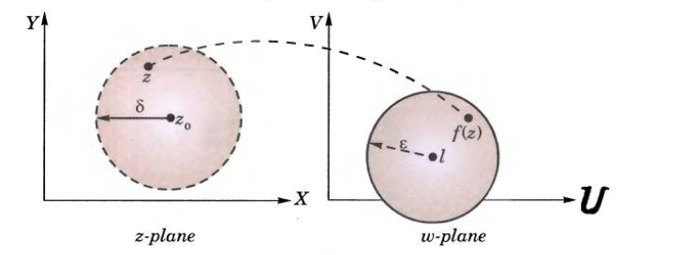
Limits: A function f(z) is said to have a limit ‘l’ as z tends to z₀ if for a given ε > 0 there exist a positive number δ such that |z- z₀ | < δ implies |f(z)-l|< ε.
In other words, distance b/w f(z) and l can be made as small as we please by bringing z sufficiently close to z₀.
Graphically the relation w = f(z) maps a point z in the z-plane to a corresponding point w in the w-plane. So it means that the point w in w-plane approaches the point w₀ = l when z approaches z_{0.}

Slide 7
Let w = f(z) be a function of z, and let u(x,y), v(x,y) denote the real and imaginary part of w. Let w₀ = u₀ + iv₀ be a fixed complex number. Then the limit of f(z), as z tends to z_{0,} is w₀ , & is written as
If limit of f(z) exists at any point, then it is unique.

Slide 8
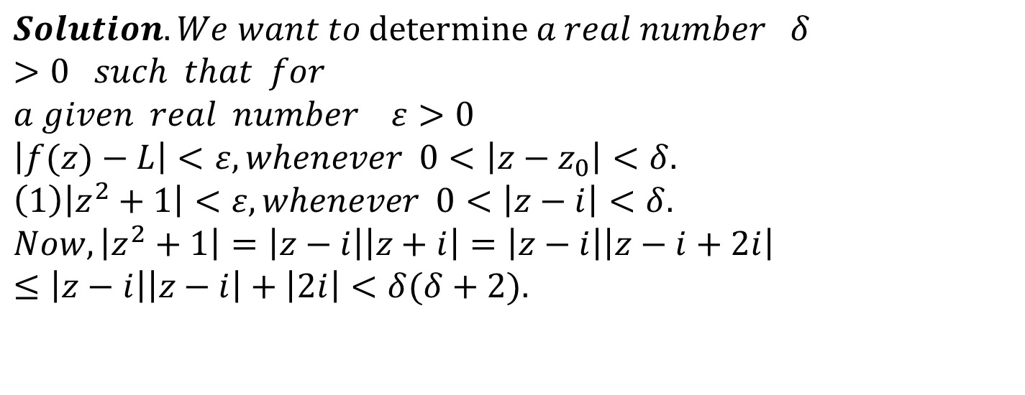
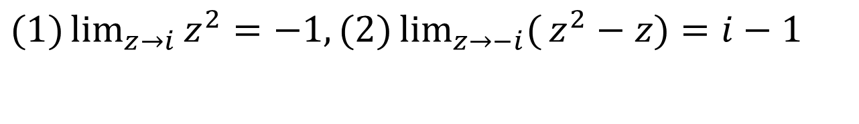
Example1: Using the definition of limits, show that
$$(1)\lim_{z→i}{z^{2}}=−1,(2)\lim_{z→−i}{(}z^{2}−z)=i−1$$
$$Solution.We want​ to \text{determine} a real number δ>0 such that for \\ a given real number ε>0 \\ \left|f(z)−L\right|<ε,whenever 0<\left|z−z_{0}\right|<δ. \\ \left(1\right)\left|z^{2}+1\right|<ε,whenever 0<\left|z−i\right|<δ. \\ Now,\left|z^{2}+1\right|=\left|z−i\right|\left|z+i\right|=\left|z−i\right|\left|z−i+2i\right| \\ ≤\left|z−i\right|\left|z−i\right|+\left|2i\right|<δ(δ+2).$$

Slide 9
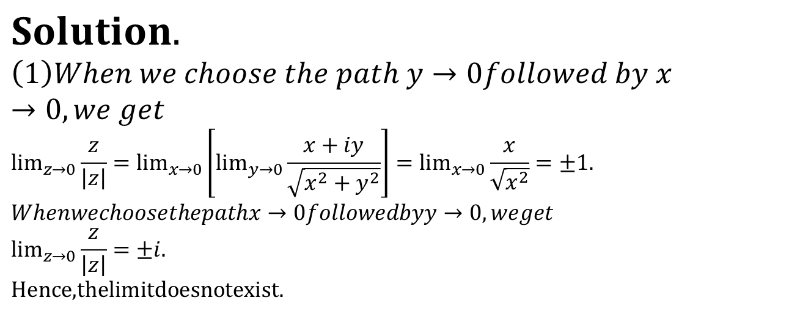
$$Solution.$$
$$\left(1\right)When we choose the path y→0followed by x→0,we get \\ \lim_{z→0}{\frac{z}{\left|z\right|}}=\lim_{x→0}\left[\lim_{y→0}{\frac{x+iy}{\sqrt{x^{2}+y^{2}}}}\right]=\lim_{x→0}{\frac{x}{\sqrt{x^{2}}}}=±1. \\ Whenwechoosethepathx→0followedbyy→0,weget \\ \lim_{z→0}{\frac{z}{\left|z\right|}}=±i. \\ \text{Hence}\text{,}\text{thelimitdoesnotexist}\text{.}$$

Slide 10
Continuity of a Function:

Slide 11
If w = f(z) = u(x,y) + iv(x,y) is continuous at z_{0,} then u(x,y) and v(x,y ) are also continuous at z = z_{0.} Conversely if u(x,y) and v(x,y ) are continuous at (x₀ ,y₀ ) , then f(z) will be continuous at z = z_{0.}
Example 3 : If the function w = f(z) is continuous at z = z₀ then show that the function

Slide 14
Differentiability
Let f(z) be a single-valued function defined in a domain D. The
function f(z) is said to be differentiable at a point z₀ , if

Slide 16
If f(z) is differentiable at z = a then it must be continuous at z = a.
A function which is not continuous at a point z = a cannot be differentiable at z = a.
A function which is continuous at a point z = a, may or may not be differentiable at z = a.
The rules of differentiation of function of real variable x hold for a function of a complex variable z.

Slide 20
Thank You

